Slide 1

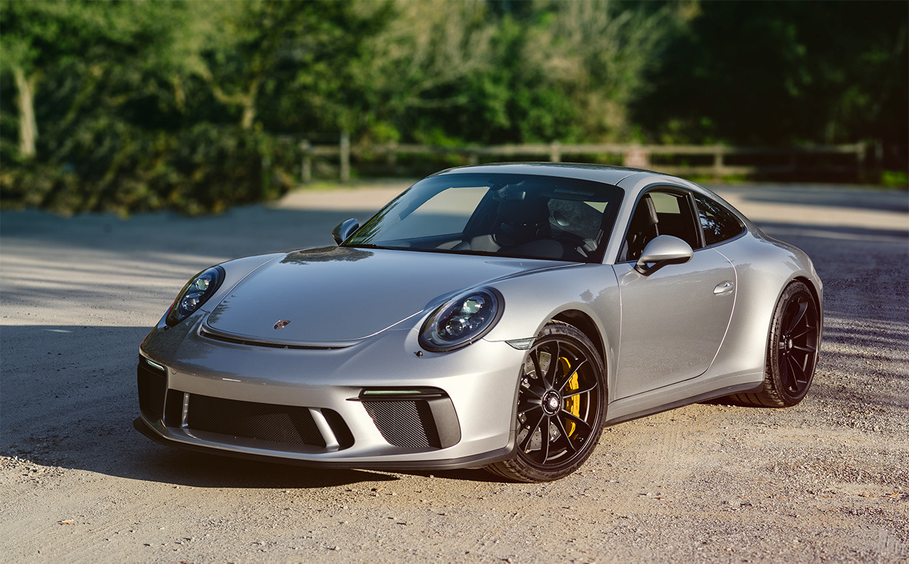
Modern technology of car
Made by – Naitik Chaubey
This Photo by Unknown Author is licensed under CC BY

Slide 2
introduction
A motor car any self-propelled vehicle with more than two wheel and a passenger compartment, capable of being steered by the operator for use on roads. The term used to denote it specifically to denote any such vehicle designed to carry a maximum of seven people.

Slide 3
Car systems:
cars are powered and controlled by a complicated interrelationship between several systems. This diagram shows the parts between the several systems of a car which includes petrol engine, manual transmission, power train, steering and brake system.

Slide 4
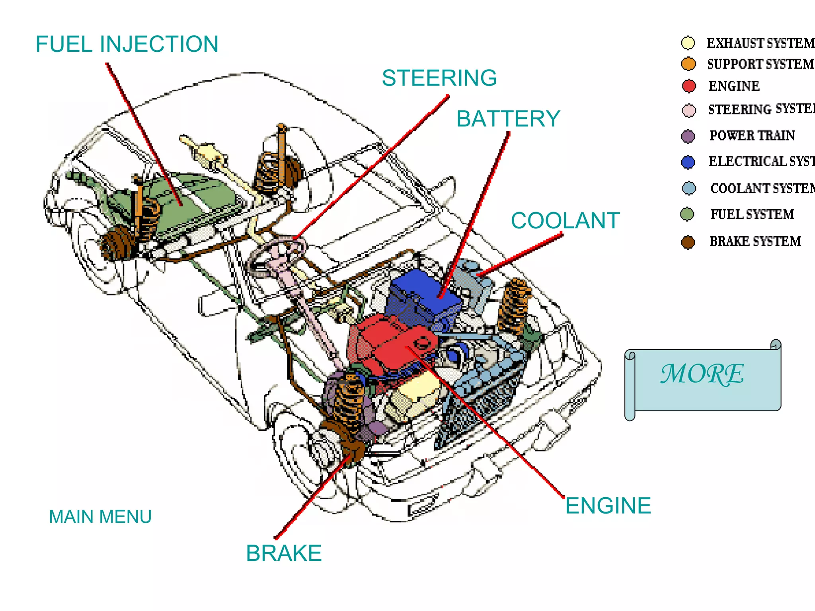
Car systems
Some part of a car are exhaust system, support system, engine, steering system, power train, electrical system, coolant system, fuel system, brake system.

Slide 5
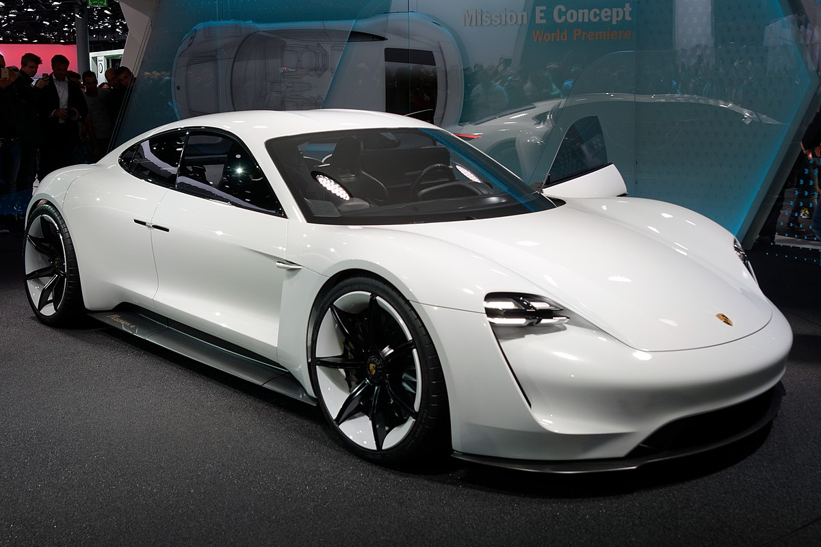
Electric cars.
In recent years, the worldwide shift to electric cars has been one of the most prominent trends in automobile industry. Environmental factors have driven the growth of zero-emission vehicle technology, and the popularity of cleaner and more environmentally friendly electric vehicles (EVs) and hybrid electric vehicles (HEVs) has increased.

Slide 6
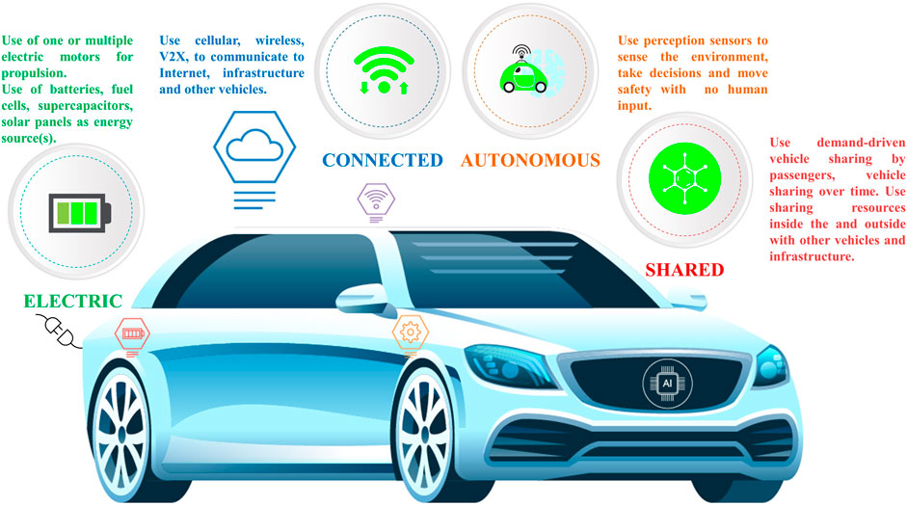
Software-defined vehicles.
Software-defined vehicles are those that use software to conduct all operations (braking, driving, steering, providing infotainment, etc.). This software should be regularly updated to let users take advantage of the latest technological advancements and enhance vehicle performance. This trend is gaining traction in 2025: at the recent Consumer Electronics Show, the event that showcases technological innovations across industries

Slide 7
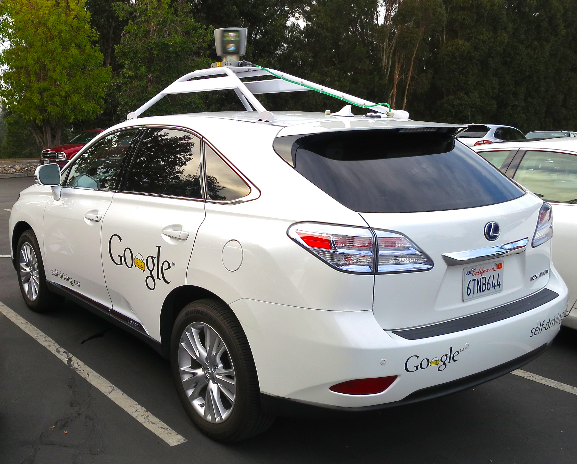
Self-driving vehicles:
Innovative manufacturers take considerable interest in the potential of autonomous driving technology since it opens new opportunities for business growth. Up-to-date, autonomous vehicles are in the early stage of development: among the 6 levels of driving automation, there are only Level 3 (conditional automation) and some Level 4 (high driving automation) vehicles available in some regions.

Slide 8
Alternative fuels:
. This is one of the new trends in automotive industry, which is to some extent in conflict with electrification. However, there are still a great number of fuel-driven cars, and despite the shift to producing electric vehicles, some car manufacturers don’t want to use batteries in their automobiles for some reason. So, the so-called e-fuels become a greener alternative to traditional fuel, which is also used beyond the automotive industry.

Slide 9
Automotive supply chain issues:
The automotive industry is one of the most severely affected by supply chain disruptions. Currently, its greatest challenge is uncertainty and instability, which are expected to persist this year

Slide 10
Connected vehicles:
Vehicle connectivity has become a really game-changing innovation in automotive industry that will transform the future of driving. Combined with 5G technology, it turns a car into a talking supercomputer being able to create wireless networks to communicate in real time with all traffic infrastructure including vehicles and traffic lights. Cars are becoming unprecedentedly smarter, and this trend is here to stay in the future.

Slide 11
Advanced safety feature:
Safety has been one of the key trends in automotive industry. 2025 is no exception—automotive manufacturers are expected to continue implementing more and more advanced safety features in their vehicles. Last year, the European Union updated the General Safety Regulation (GSR) and establishes mandatory safety requirements for cars sold in the EU.

Slide 12
Mobility-as-a-service (MaaS)
Mobility-as-a-Service has been among the latest trends in automotive industry for some years—it has become a popular convenient and cost-effective alternative to traditional car ownership and personal vehicles. The technology involves the integration of diverse transportation means into a single platform for delivering all-embracing mobility services. The platforms may include public transportation, taxis, micromobility vehicles, car leases, or their combinations.

Slide 13
3D printing: revolution in automotive manufacturng
The main advantage of this digital technology is that it allows auto manufacturers to create complex and at the same time lightweight vehicle parts. 3D printing them is faster than traditional manufacturing and cheaper, which makes the whole process more efficient. Also, additive manufacturing makes prototyping more rapid, which enables faster design and testing periods for new vehicles.

Slide 14
5G: advanced connectivity
Connectivity is one of the key trends in automotive industry, and 5G is what takes it to a more advanced level. 5G facilitates faster data transmission, higher network and bandwidth capacity as well as improves security (e.g., protection from cyberattacks). As a result, vehicles become even more connected with each other and the infrastructure and provide drivers with more advanced opportunities.

Slide 15
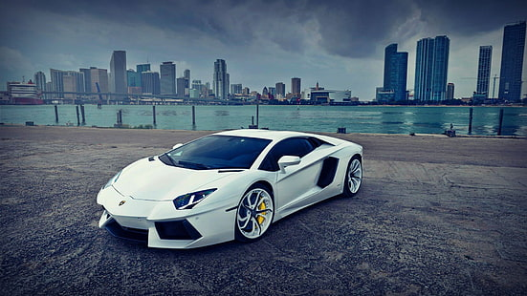
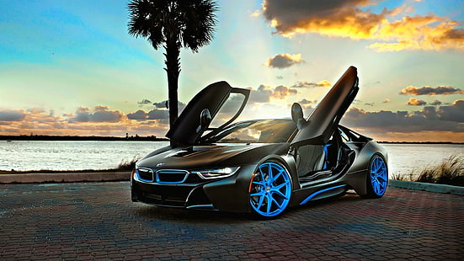
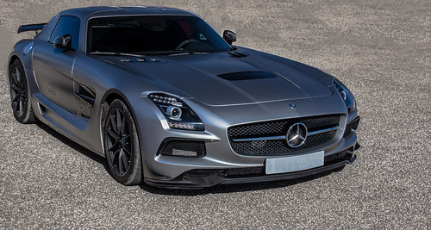
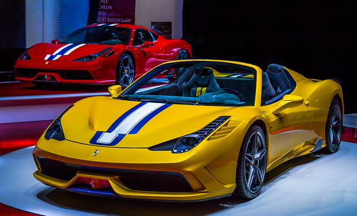
some of the cars of modern era:
lamborgini
B.M.W
mercedes
ferrari

